Slide 1

Public - Private Dialogues and the Policy Process
Suresh Babu
Senior Research Fellow
International Food Policy Research Institute, Washington D.C.
at
Workshop on Public Private Dialogue in Nepal
January 12th, 2016
Kathmandu, Nepal
12th January 2016

Slide 2
Overview
Introduction
Conceptual Framework – The Kaleidoscope Model
Policy Process and Public Private Dialogue
Some Lessons
Conclusions

Slide 3
PPD Definition
“PPDs are structured mechanisms,
anchored at the highest level of government, coordinated by a light secretariat, and
aimed at facilitating the reform process by involving a balanced range of public and private sector actors
in identifying, filtering, accelerating, implementing, and measuring policy reforms.”
Source:www.publicprivatedialogue.org

Slide 4
Stages of Policy Process
Agenda Setting
Policy Design
Policy Adoption
Policy Implementation
Policy Evaluation and Reform

Slide 5
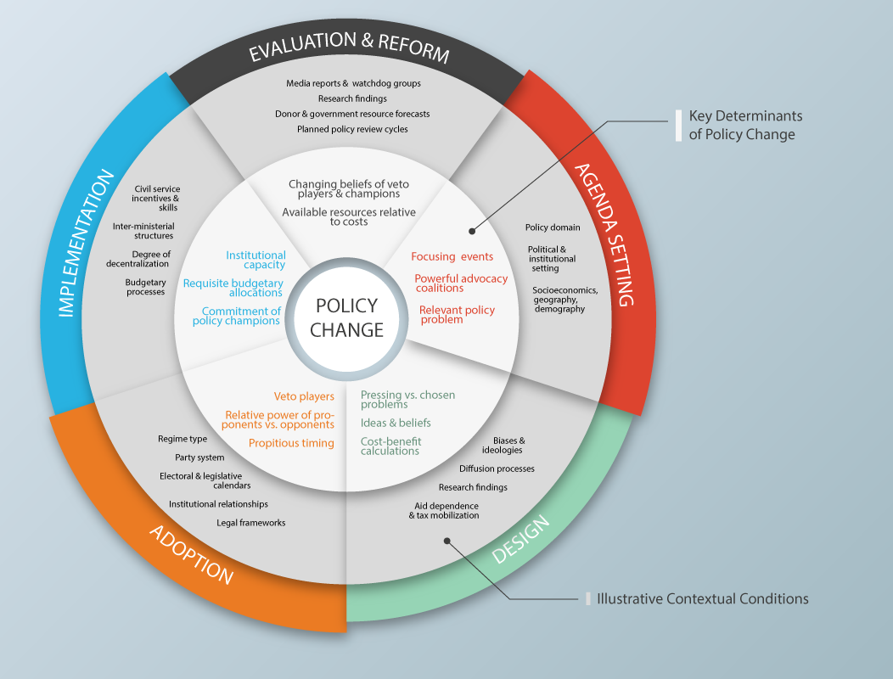
A Model of Policy Process Source: Resnick et al (2014)

Slide 6
Tools for Analyzing Policy Process
Policy chronologies –process tracing by indicating whether certain events precipitated subsequent policy changes
Agricultural policy mapping-identifies key institutions and frameworks, regulations, procedures, etc.
Policy domain mapping-roles of key actors (e.g.formulation, administration, oversight, or knowledge)
Stakeholder inventories -identifies perceived winners and losers and their preferences
Circle of influence graphics -aligns stakeholders in a two dimensional space to map their preferences vis-à-vis a policy with their power
Source: Resnick et al (2015)

Slide 7
Policy Process and Public – Private Dialogue
  The concept of PPD relates to Policy Process in major ways:
  Private sector need to play a role in all stages of policy process
  Making Policy process more inclusive – from the Private sector perspective
  Helps in bringing specific policy changes that impede role of private sector in development process
  Helps to focus on specific sector or sub-sector – going beyond broad policy statements and strategies

Slide 8
Why are PPDs important in the Policy Process?
  Declining budget allocation for the public services by the Governments and donors
  Transformation of agriculture from subsistence level to commercialized agribusiness
  Concerns on efficiency and effectiveness of public vs private provision of services
  Inclusive policy process can help speed up the implementation of policies and programs
  Private investments and involvement supplement and complement the public extension
  Decentralization of public services could benefit from private sector involvement

Slide 9
Knowledge and implementation gaps
  What is the difference between private and public objectives in the policy system?
  What regulatory mechanisms and institutional arrangements must be developed to support private sector?
  What are the innovations that private sector needs for its effective involvement in policy process?
  What are the motivations and incentives for private companies for knowledge sharing?
  What are the opportunities for creating Win-Win for both Private and Public sectors?
  What role can policymakers play in shaping and supporting inclusive policy process?

Slide 10
Issues in the context of Nepal Agriculture
Private sector can play effective role in the agricultural growth process along with cooperatives and public sector
Private sector can play an important role in the input delivery, pluralistic extension system, and in the processing and marketing of the produces
Private sector programs for value chains are effective, but their coverage is limited
Creating private sector friendly policy environment requires consultations and dialogues throughout the policy process?
Public-private partnerships can increase the efficiency and effectiveness of the public policy design and implementation – PPDs can play a key role
Need better understanding of costs and benefits of involvement of private sector or otherwise

Slide 11
Conclusions
Role of Private sector in the policy process needs to be identified and encouraged
Need to monitor nature of policy environment – are they private sector friendly
How PPDs can help in dispute resolution and speeding up the private sector role
How to avoid the risks that come with Private sector participation in policy process?
The scale (and scope) of private sector depend on their inclusion in policy making and implementation

Slide 12
Thank you!

